Slide 1
Neural Mesh Models For 3D Part Detection
Chuanruo Ning
Supervised by: Angtian Wang Adam Kortylewski

Slide 2
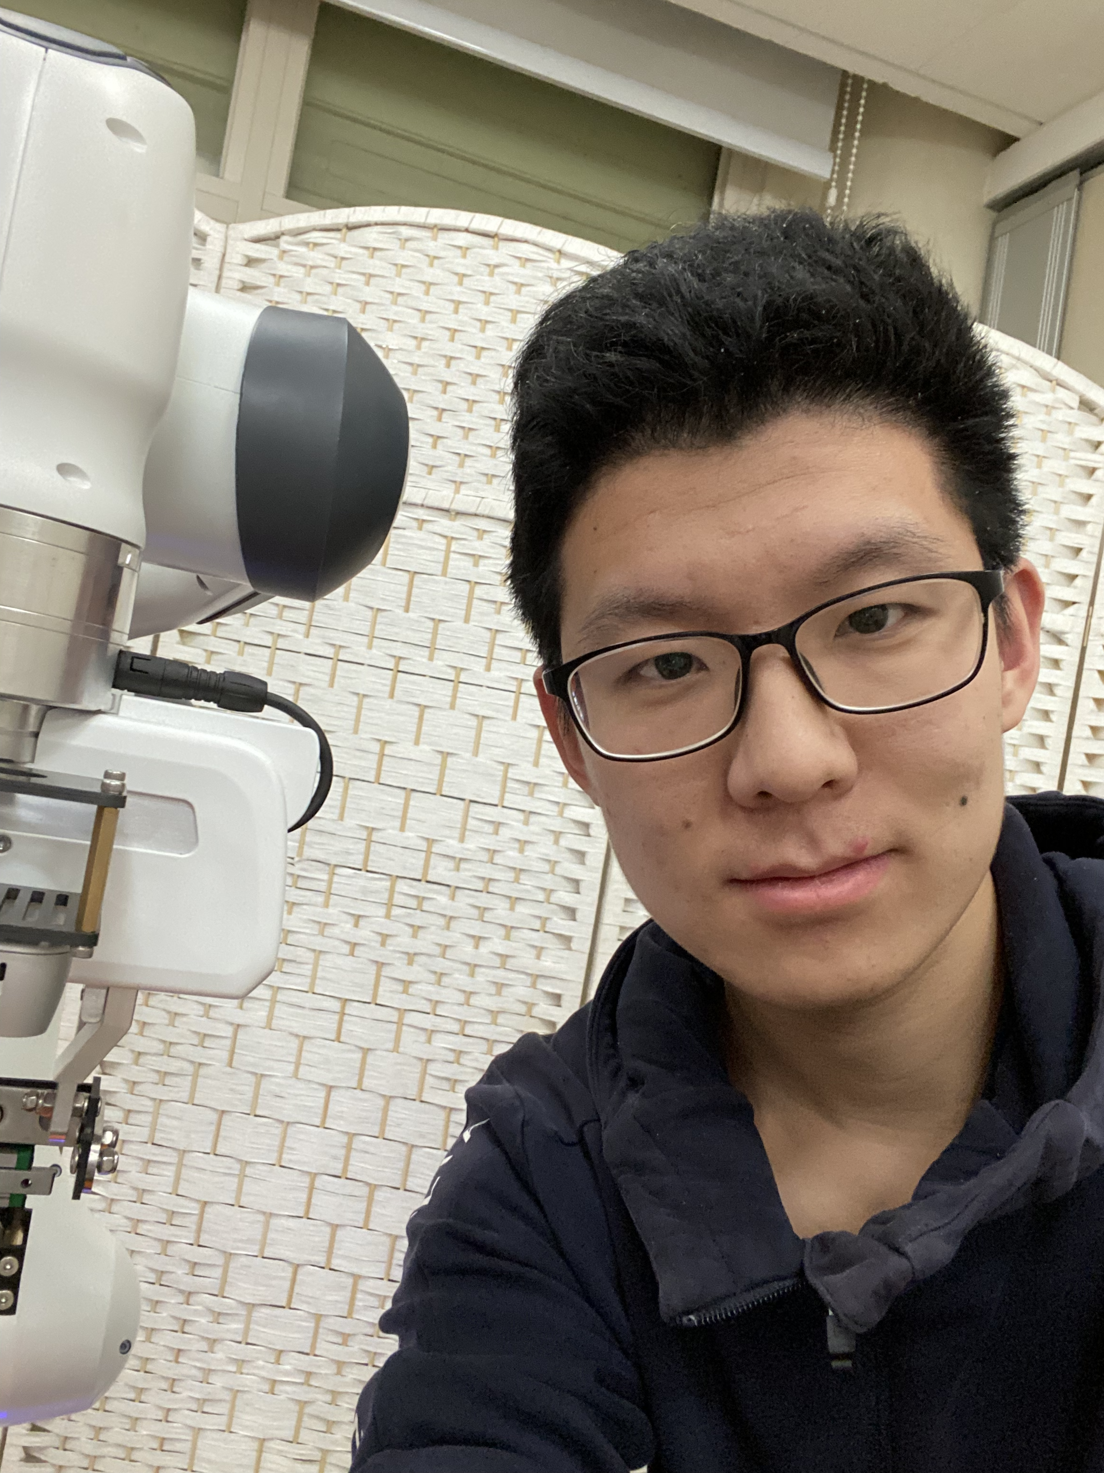
Self-introduction
Chuanruo Ning (宁川若)
Rising senior at Turing Class, Peking University
Non-CS interests: badminton, photography, music and reading
Previous works
Deformable object manipulation. Accepted by ICCV 2023
Few-shot learning on articulated object manipulation. Under review of NeurIPS

Slide 3
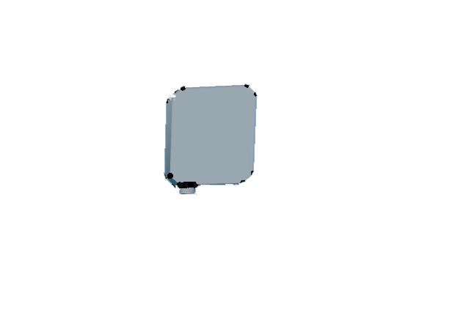

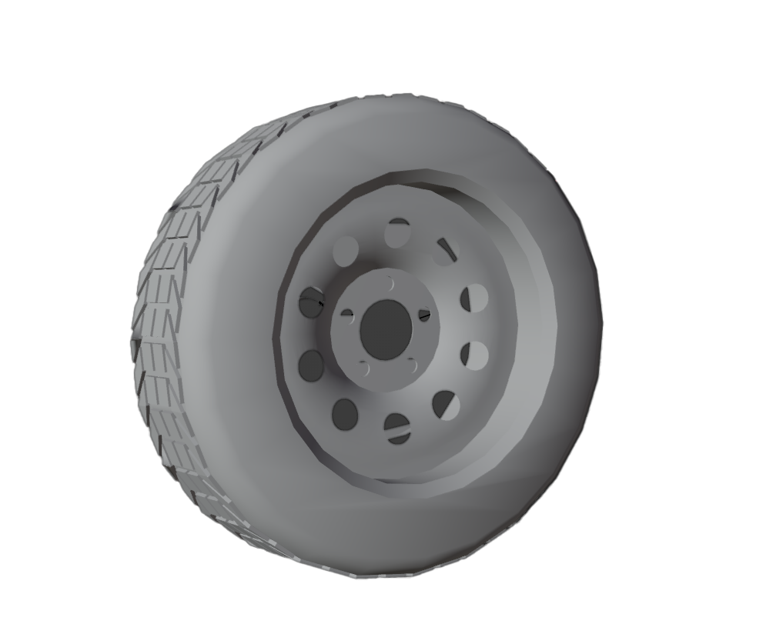
What is 3D Part Detection?
Detect precise 3D parts from a single image
Unseen single image
Precise 3D parts

Slide 4
Extend Render-and-compare Method to Part Detection
NeMo’s perspective
Current NeMo features are optimized for pose estimation
Part-level features enable NeMo to capture precise geometric information
3D Part detection
Recognizing parts are crucial for 3D understanding
Render-and-compare method provides 3D global prior for detection

Slide 5
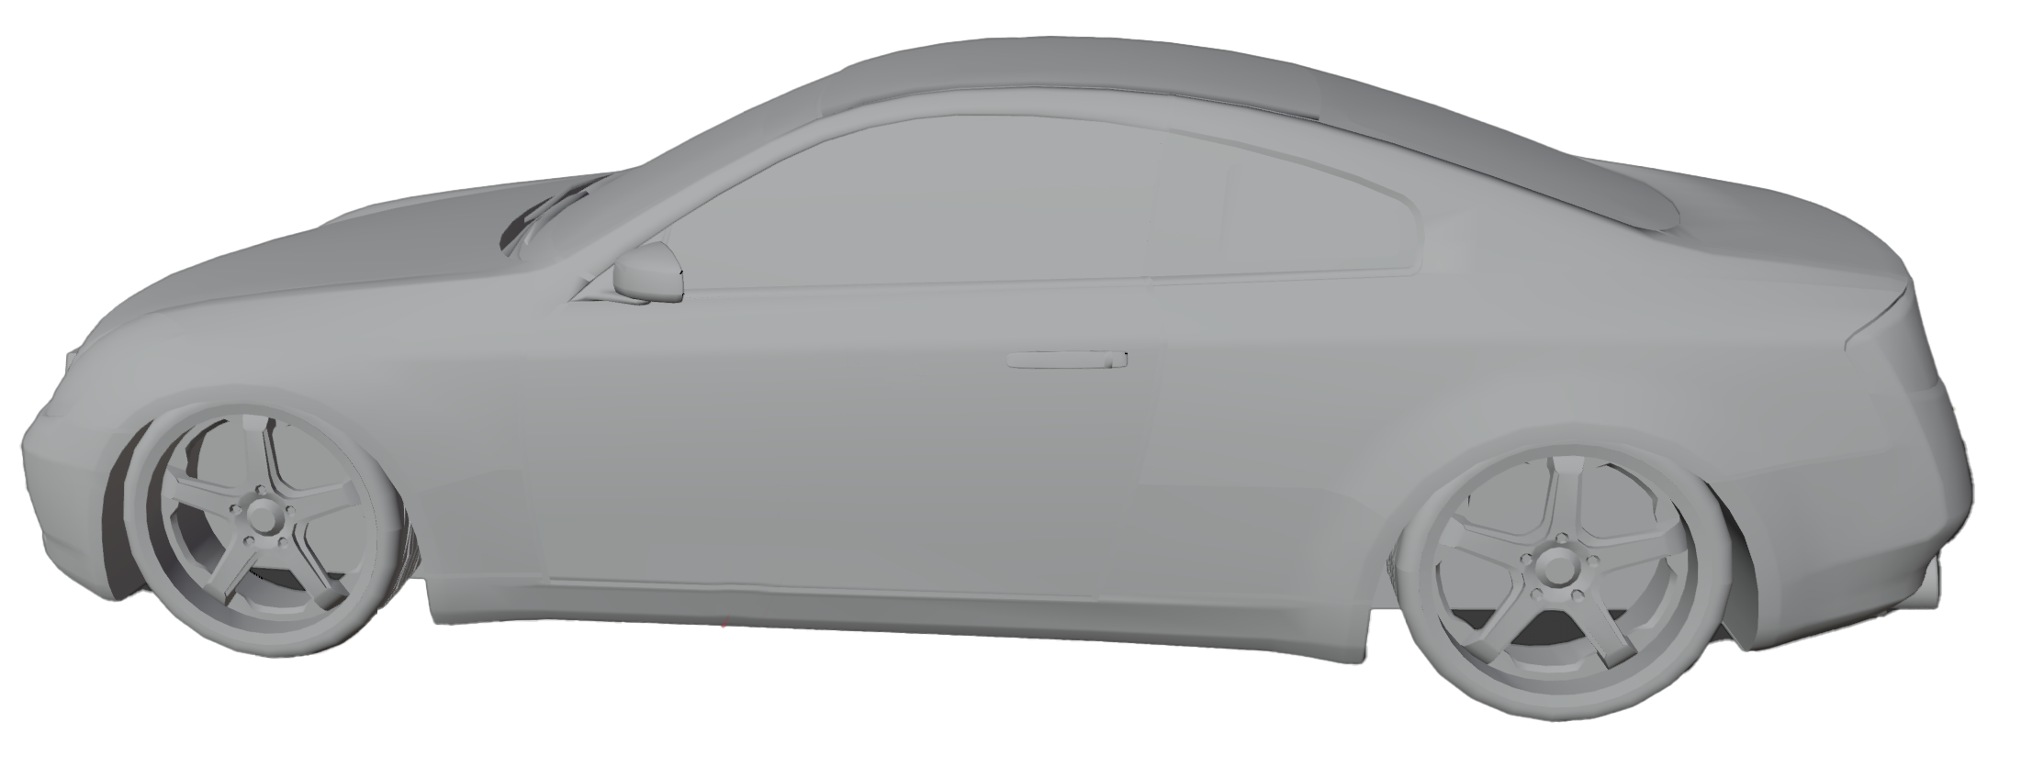
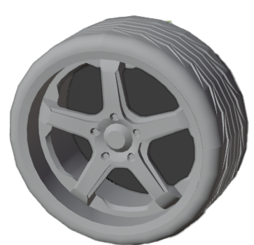
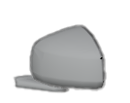
3D Part Detection
Detect precise 3D parts from a single image
Part annotations on
a single instance
Unseen single image
Precise 3D parts

Slide 6
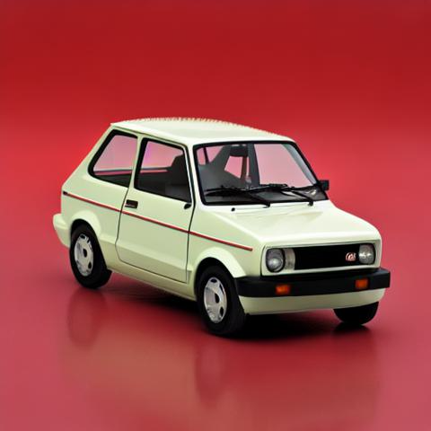
How to Perform 3D Part Detection with Render-and-compare?
Locate ---- Orient ---- Deform
Input image
Locate
Orient
Deform
3D part from
a different instance

Slide 7
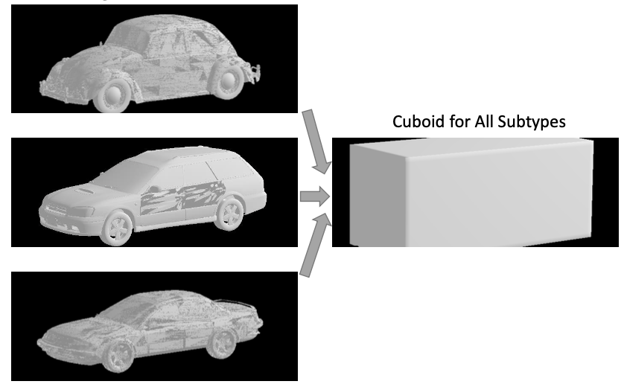
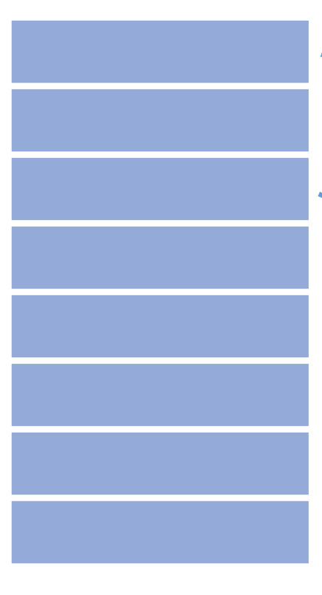
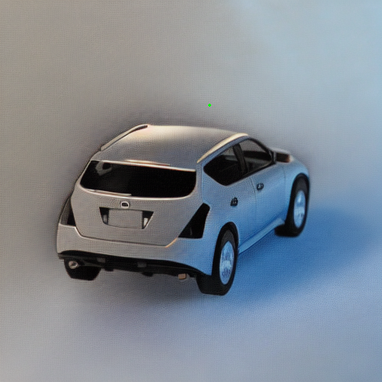
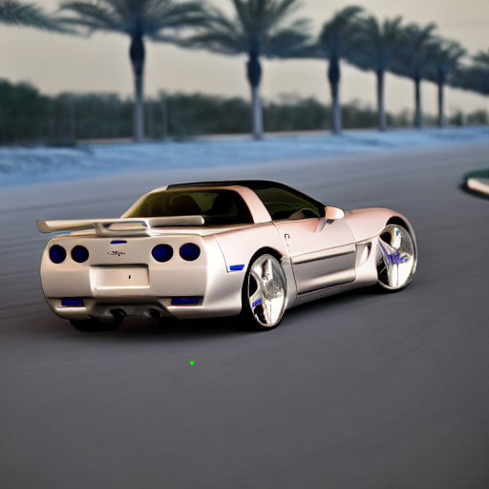
More Precisely Aligned NeMo
NeMo leverages coarse alignment to perform robust pose estimation
Features Bank
We need a more precise alignment between vertex features and 2D images

Slide 8
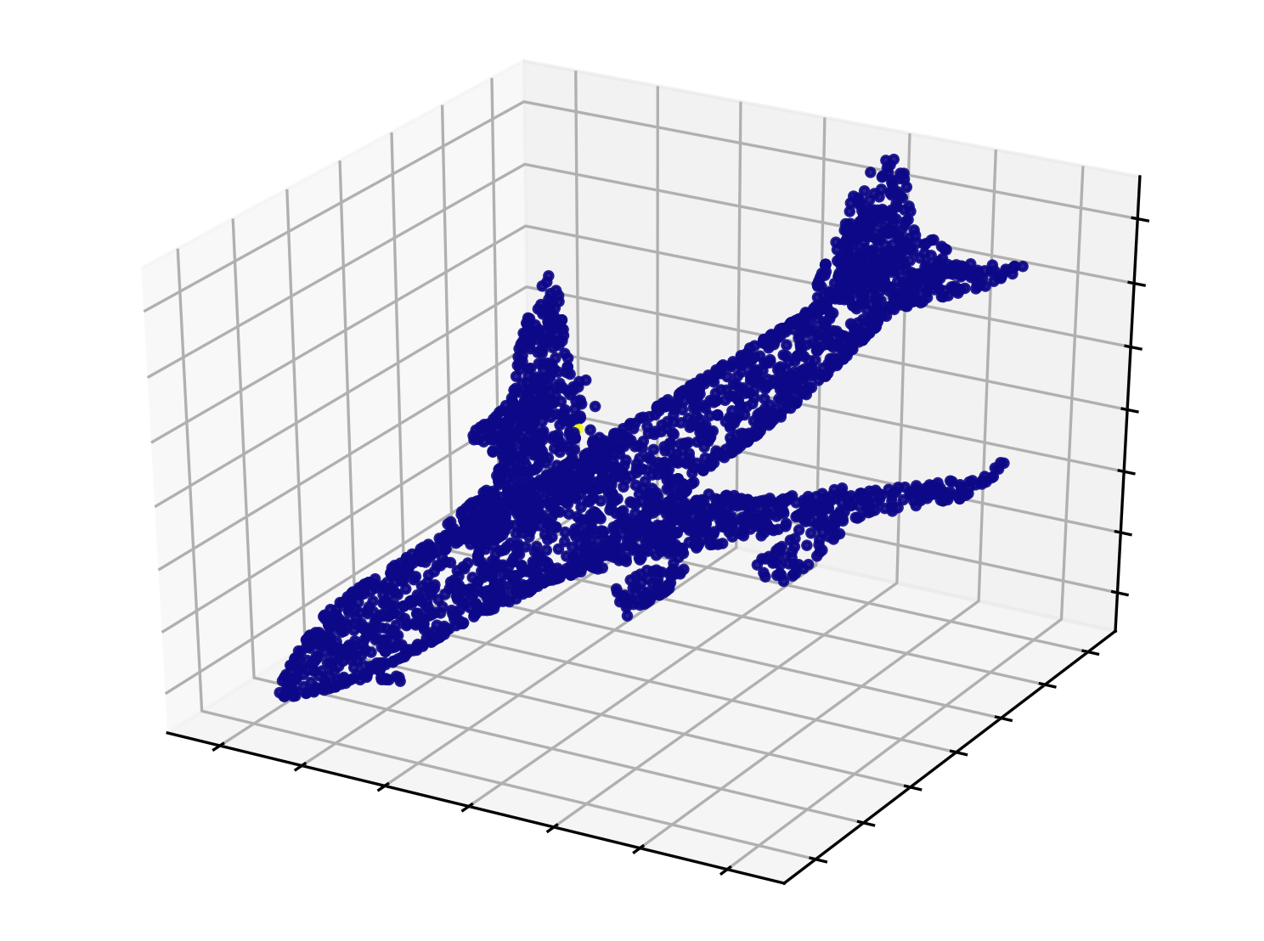
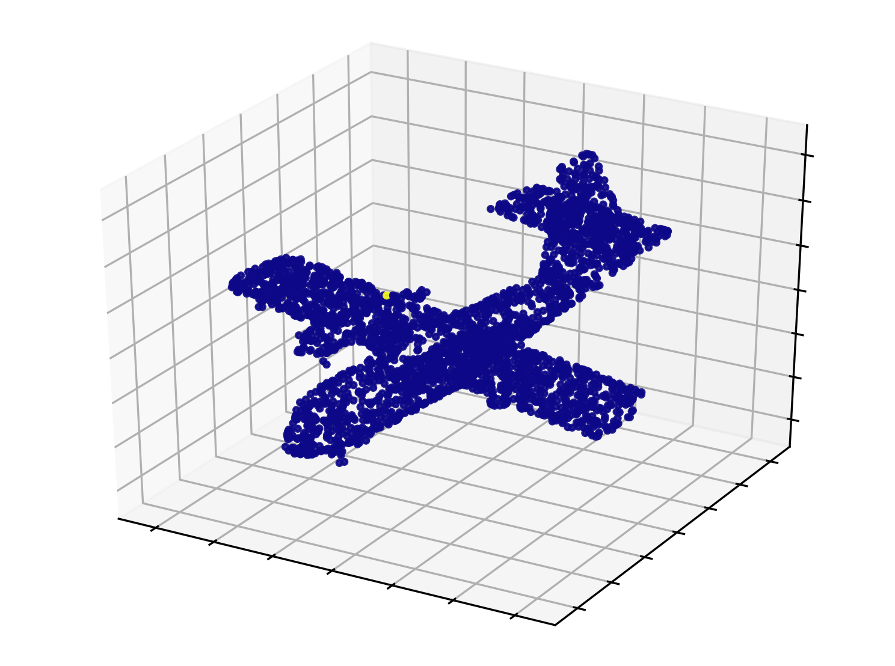

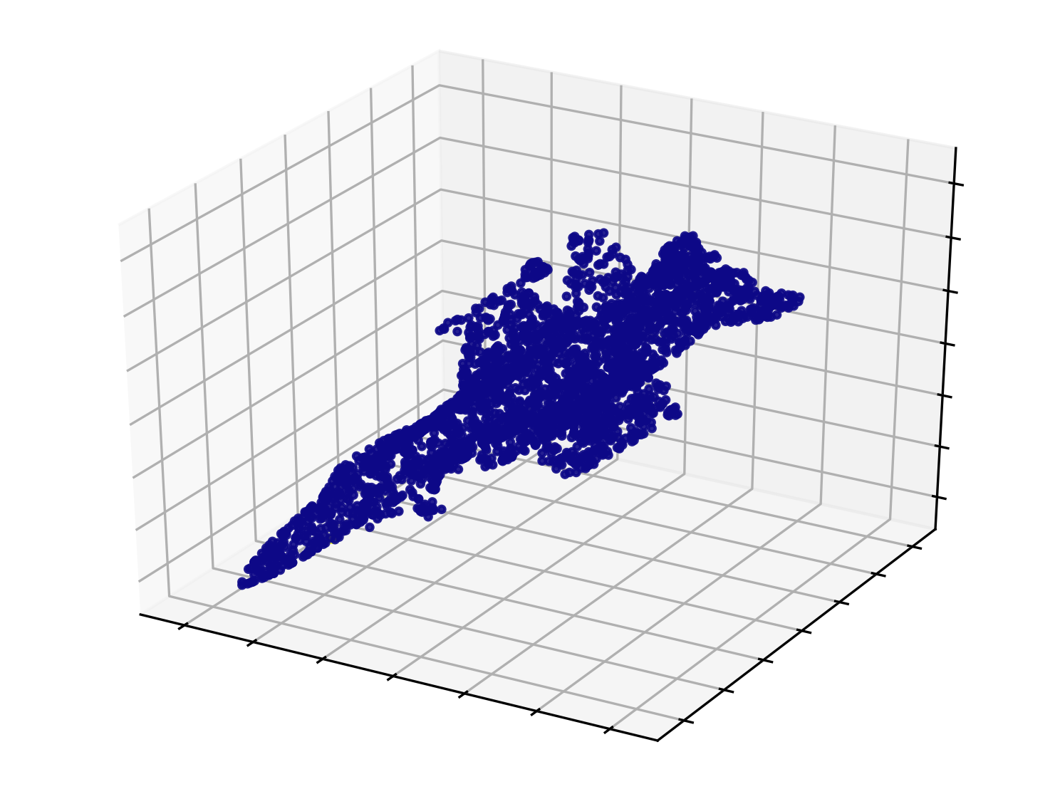
More Precisely Aligned NeMo
Correspondence across instances
[1]
[1] Canonical Capsules: Self-Supervised Capsules in Canonical Pose

Slide 9
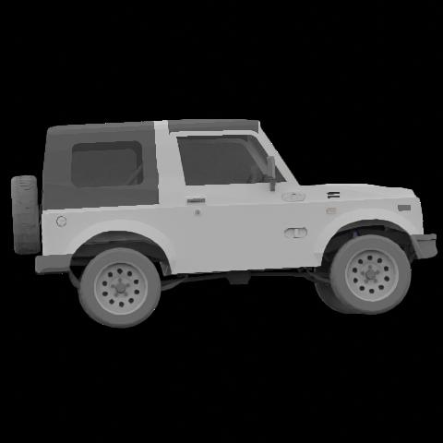
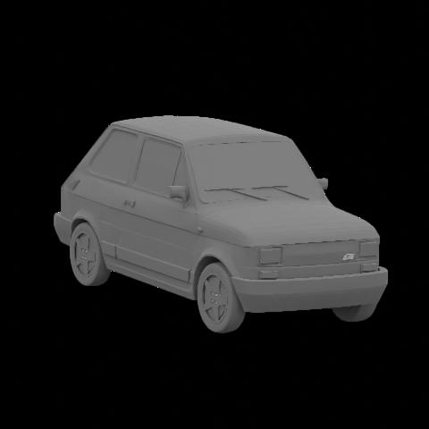
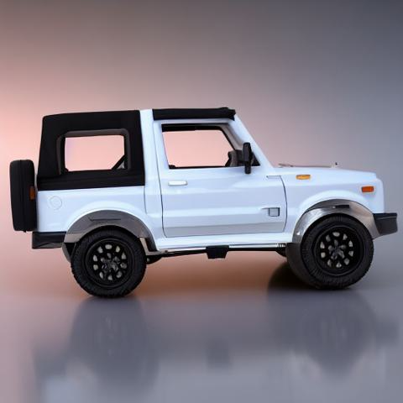
More Precisely Aligned NeMo
Use correspondence to share features among precise shapes
Precise
Alignment
Precise
Alignment
Coarse
Alignment
[2]
Feature Bank
Original NeMo
Precise NeMo
[2] Adding 3D Geometry Control to Diffusion Models. arXiv preprint arXiv:2306.08103.

Slide 10
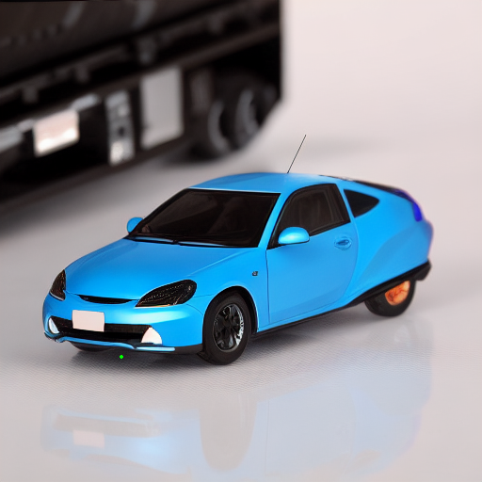
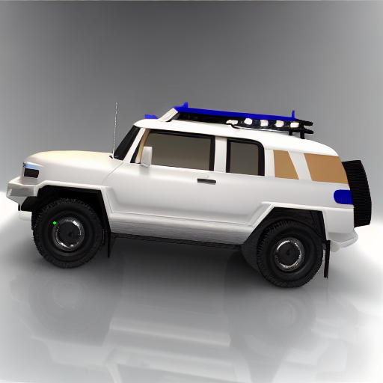
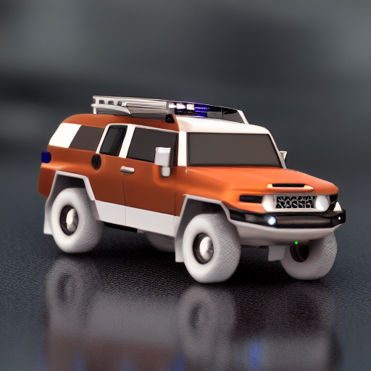
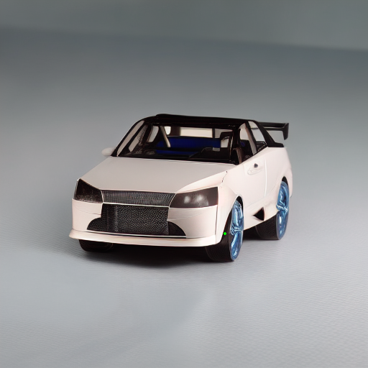
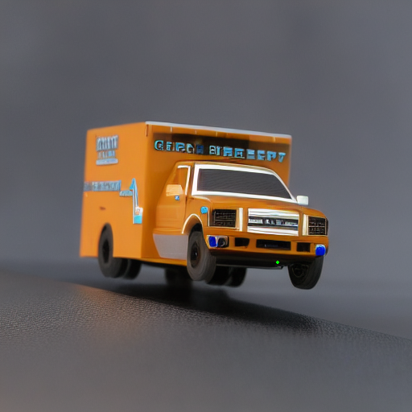
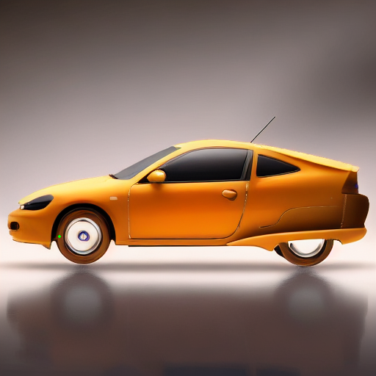
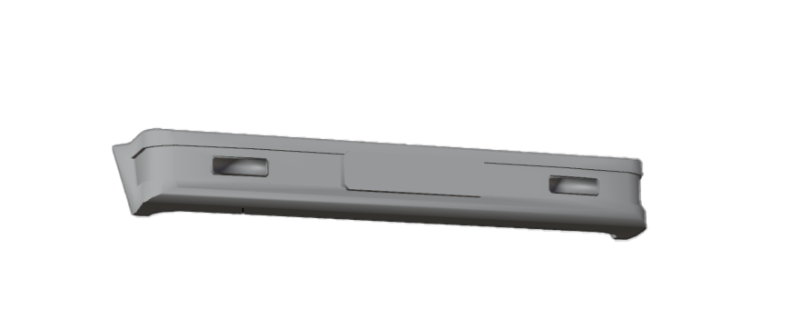
Locate & Orient with Precise NeMo
Results
Feature Bank

Slide 11
Locate & Orient
Results

Slide 12
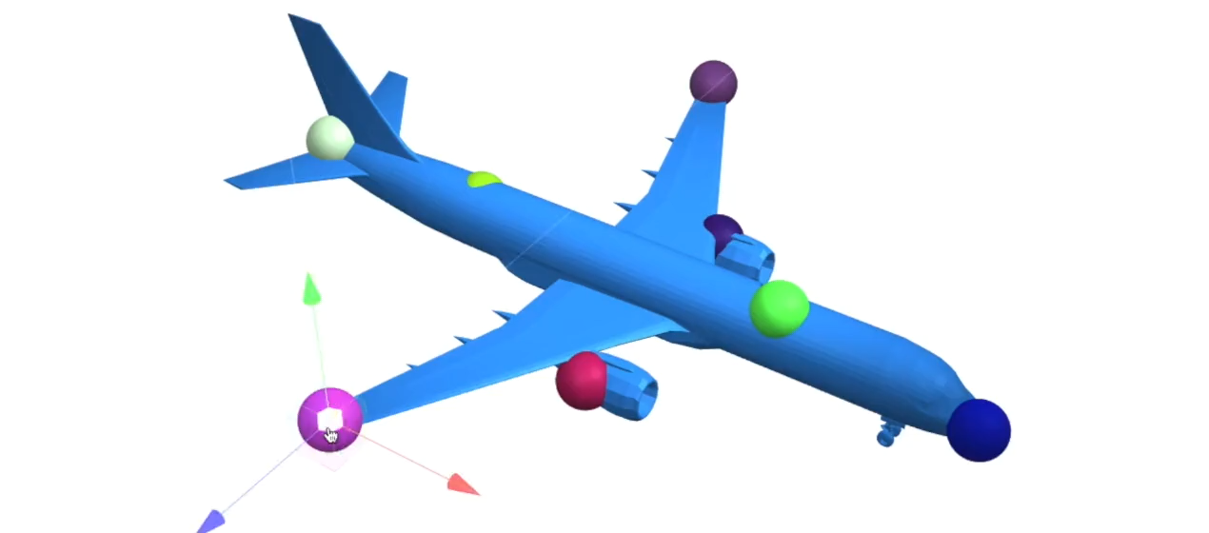
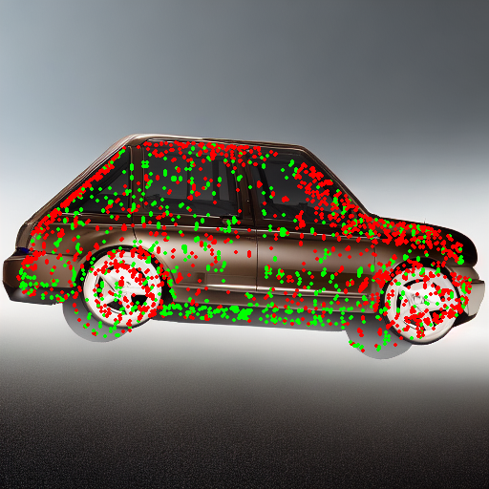
Deform by Changing The Position of Aligned Points
Through gradient decent process
Points with aligned features
Deform using key points [2]
Need some constraints (to be explored)
[2] KeypointDeformer: Unsupervised 3D Keypoint Discovery for Shape Control

Slide 13
Neural Mesh Models For 3D Part Recognition
Questions are welcomed
Thank you for Listening!

